Slide 1
CSE4095
Introduction to NLP
Iteration 1
GROUP 4
150116024 Ahmet Elburuz Gürbüz
150117018 Ahmet Önkol
150117023 Anıl Şenay
150117030 Beyza Aydoğan
150117072 Bilgehan Geçici
150116020 Muhammet Kürşat Açıkgöz

Slide 2
DEVELOPMENT PROCESS
There are three steps to extract collocations:
Preprocessing
Removing stopwords
Stemming and Lemmatization
Extracting the Bigrams and Trigrams
Generating Collocations using related methods

Slide 3
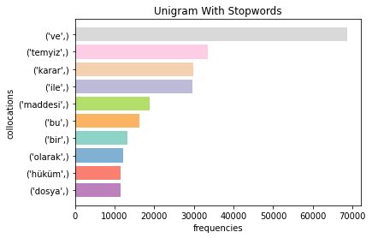
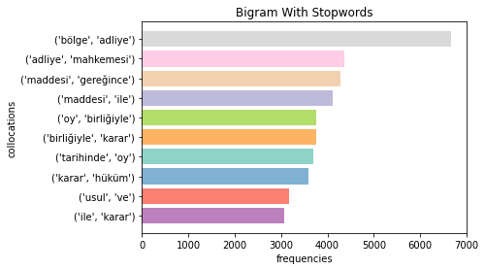
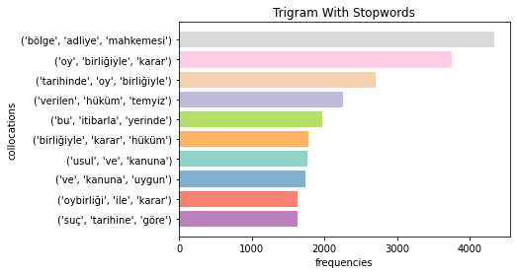
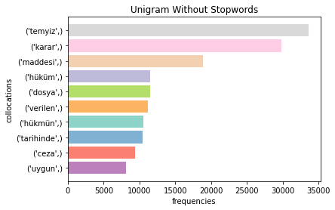
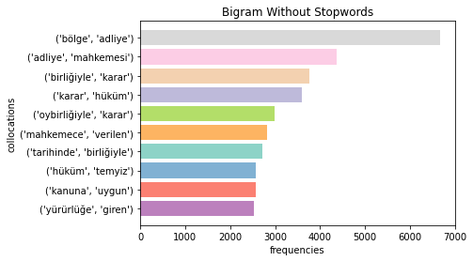
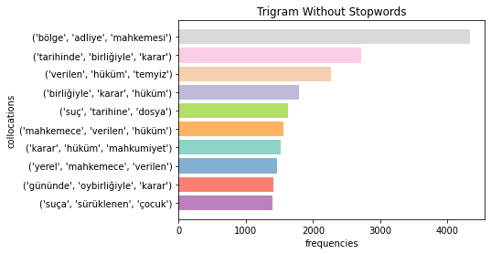
N-GRAM FREQUENCIES

Slide 4
METHODS
RAW FREQUENCY
PMI
T-Test
Chi-Square
Likelihood Ratio
Poisson Stirling

Slide 5
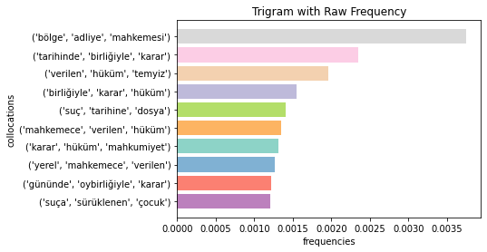
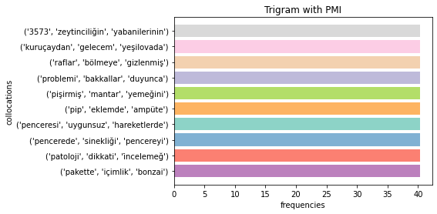
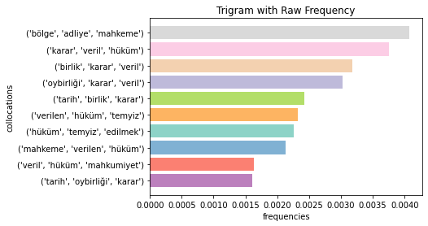
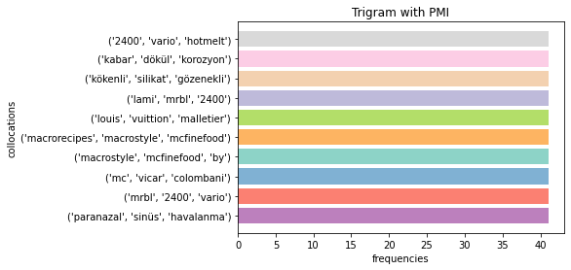
RAW FREQUENCY
PMI
Without Stemming
Without Stemming
With Stemming
With Stemming

Slide 6
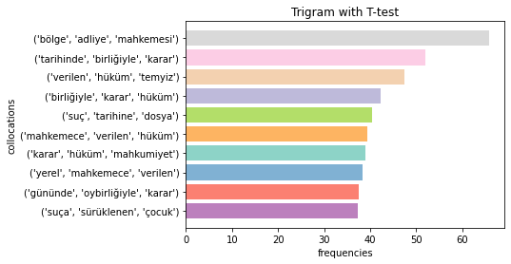
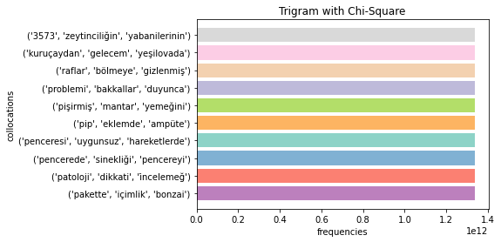
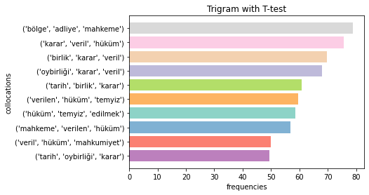
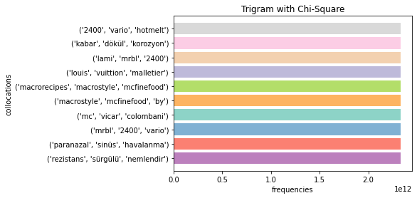
T-TEST
CHI-SQUARE
Without Stemming
Without Stemming
With Stemming
With Stemming

Slide 7
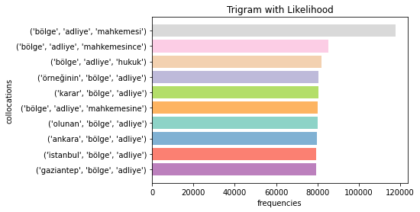
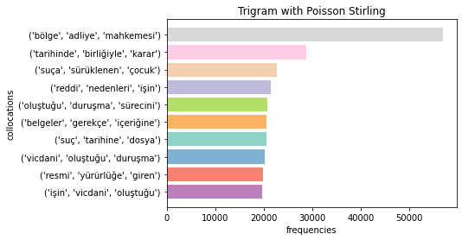
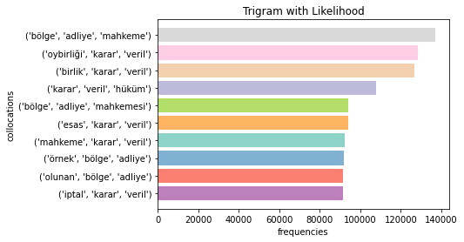
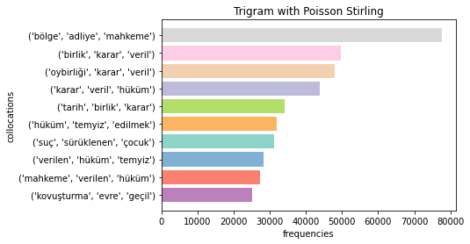
LIKELIHOOD RATIO
POISSON STIRLING
Without Stemming
Without Stemming
With Stemming
With Stemming

Slide 8
Comparison of
Methods

Slide 9
Without Stemming
Without Stemming
Without Stemming
Without Stemming
Without Stemming
Without Stemming

Slide 10
With Stemming
With Stemming
With Stemming
With Stemming
With Stemming
With Stemming

Slide 11
Thanks!

